Slide 1
WM-3 Intelligent Robot Arm
CS4850 - Sections 03 & 04
Prototype Presentation
By Zhiwen Zheng and Ellie Ireland
Notes:
Introduce ourselves - both

Slide 2
Objectives & Overview
Our aim
The goal
Implement a robotic manipulator and mobile robot together
Achieve autonomous navigation
Pick and place system
Apply machine vision and machine learning to an integrated robotic system
Train the model with a predefined dataset
Deploy the system in a physical environment
Notes:
Objectives and goals - Ellie

Slide 3
Hardware

Slide 4
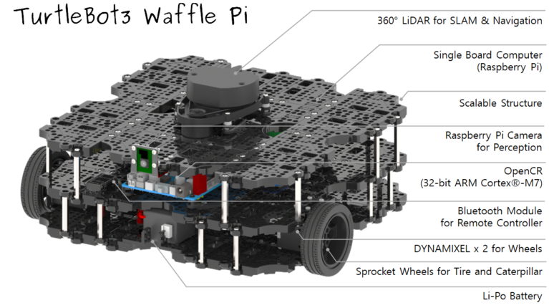
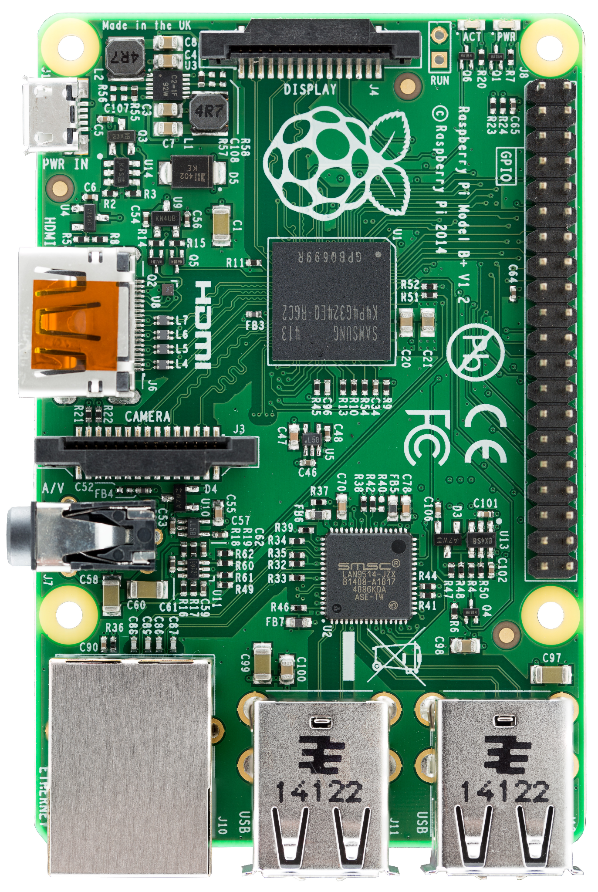
TurtleBot3 Waffle Pi
Mobile robot by ROBOTIS equipped with a camera, LIDAR, and a Raspberry Pi microcomputer
Notes:
TurtleBot3 Waffle Pi - Ellie

Slide 5
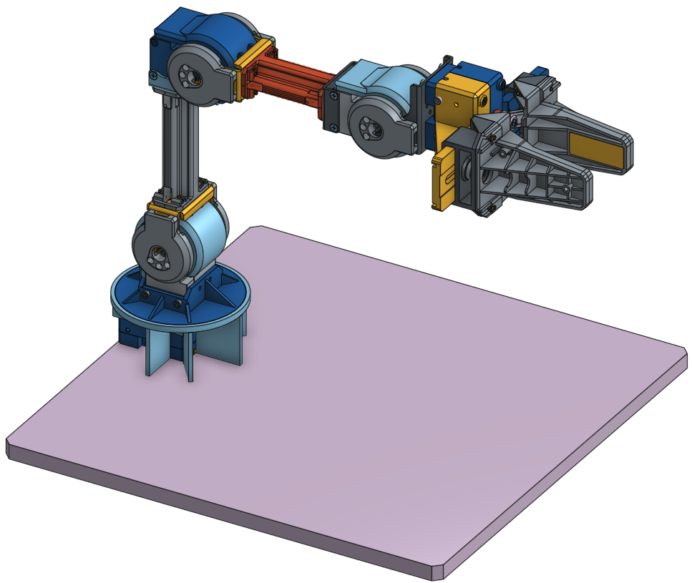
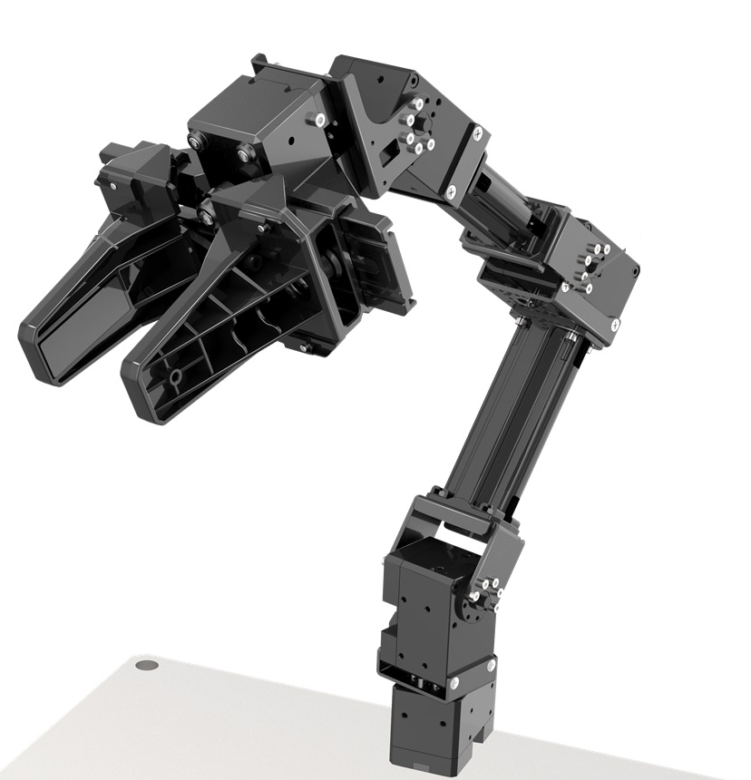
OpenManipulatorX
Robotic manipulator by ROBOTIS with five degrees of freedom
Notes:
OpenManipulatorX - Zhiwen Zheng
OpenManipulator X, is the manipulator we will use in our project. This manipulator supports ROS and also is fullly compatible with TurtleBot3​. You can find the stl files about this manipulator online because it is open-sourced on hardware, which means we can modify the length of the links or the design of the robot for our own purpose. This manipulator has four joints, one joint is at the base part, where will be connected with waffle pi. That one doesthe horizontal rotation. The other three in the second picture are the cylindrical part marked as light blue and blue. They can do the vertical rotation. The gripper is controlled by a single motor, which moves in parallel.

Slide 6
Timeline
ROBOTC
ROS
Gazebo
NVIDIA Isaac
Model Simulation
Hardware Application
Notes:
TImeline - Zhiwen

Slide 7
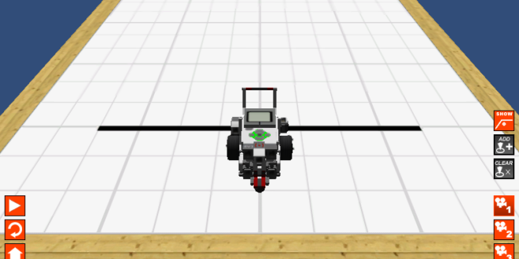
ROBOTC
C based simulation environment for designing and testing robot configurations
We utilized this tool as an introduction to robotics and model setup
Virtual world loaded with default robot model depicted below
Image sourced from Google Images
Notes:
ROBOTC - Zhiwen Zheng
ROBOTC is a programming language and development environment designed for educational robotics. It is based on the C language and is optimized for programming microcontrollers, such as those used in VEX, LEGO, and other educational robotics platforms. When we used this software, we were mainly focusing on using this for design and test robot configurations we created based on the example projects in ROBOTC. With the help of ROBOTC, we learnt how to

Slide 8
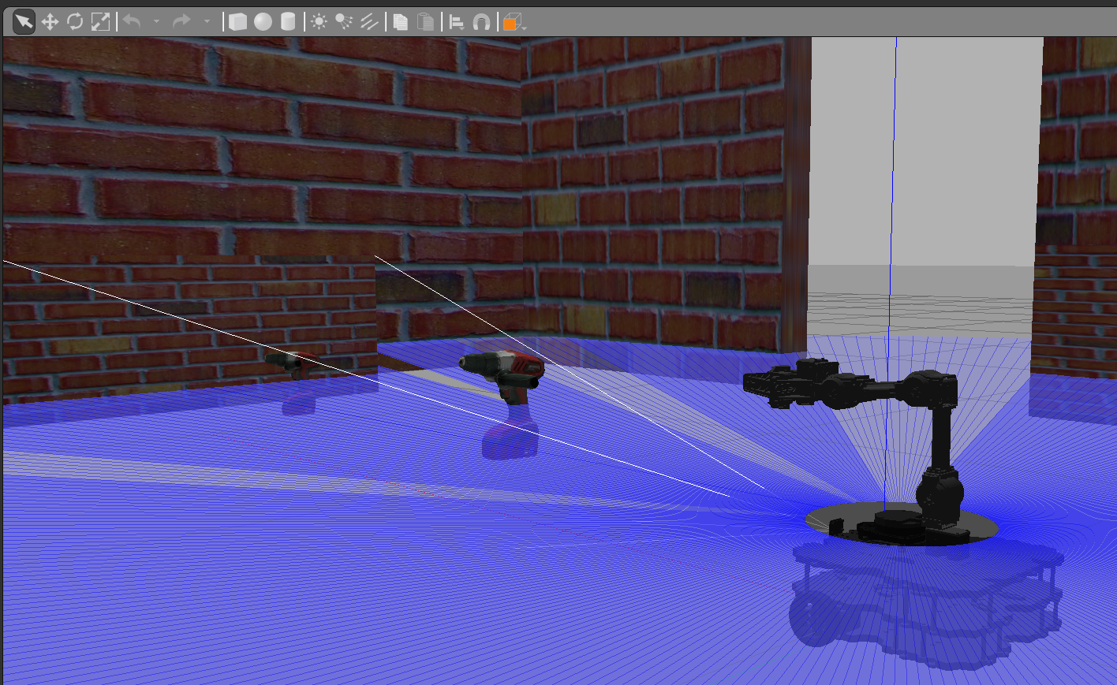
ROS and Gazebo
ROS
Gazebo
Set of software libraries for building robot applications
Uses a CLI for scripting and control
Implementation via nodes
Communicate between individual robotic components
Allows for the entire system to act together
Includes tools for robot simulation and visualization
Simulation environment hosted on ROS
Allows models to interact with world objects
Notes:
ROS and Gazebo overview - Ellie
ROS (Robot Operating System) is an open-source framework that provides tools and libraries for building and controlling robots. It facilitates software development for robotics by offering hardware abstraction, device drivers, communication between processes, and package management. ROS supports modular design, enabling developers to create reusable components and easily integrate sensors, actuators, and algorithms. It is widely used for applications ranging from simple robotics projects to complex autonomous systems, and it includes simulation environments, visualization tools, and packages for tasks like navigation, perception, and manipulation.
Gazebo is an open-source 3D robotics simulator that provides a realistic environment for testing and developing robot models. It allows users to simulate complex indoor and outdoor scenarios with accurate physics, sensor data, and dynamic interactions. Gazebo integrates with ROS, enabling developers to test algorithms, robot designs, and behaviors in a virtual environment before deploying them on physical robots. It supports various sensors, actuators, and robot models, making it a versatile tool for research, prototyping, and education in robotics.

Slide 9


Slide 10
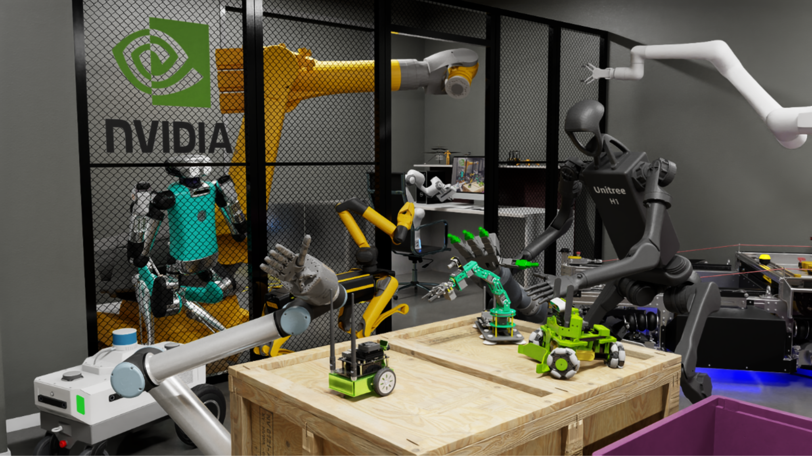
NVIDIA Isaac
Isaac Sim is a software platform built by Nvidia.
Comes with a collection of workflows for importing and tuning mechanical systems designed in the most common formats
Can directly access to Nvidia Geforce RTX GPU to support the simulation of various kinds of sensors (cameras, LiDAR, and contact sensors)
Notes:
NVIDIA Isaac - Zhiwen Zheng

Slide 11
Model Simulation

Slide 12
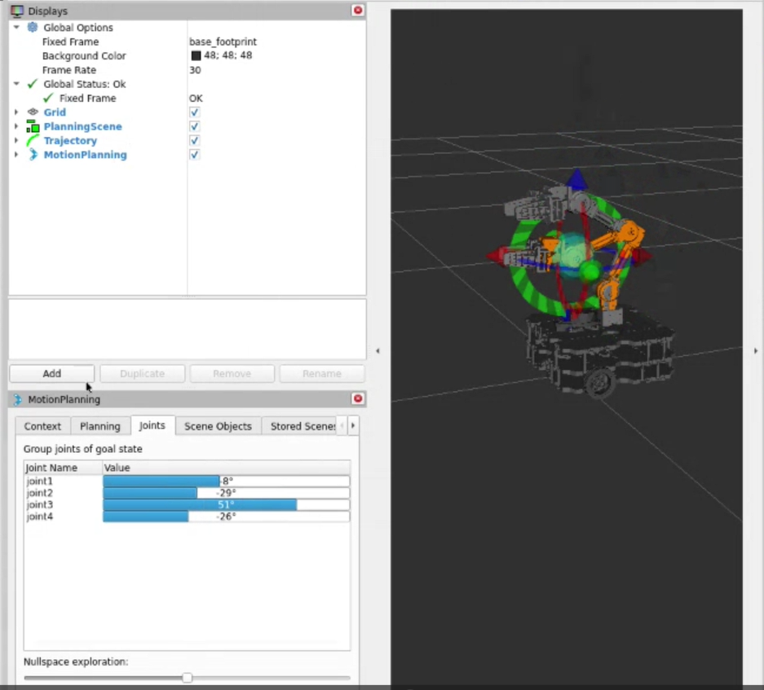
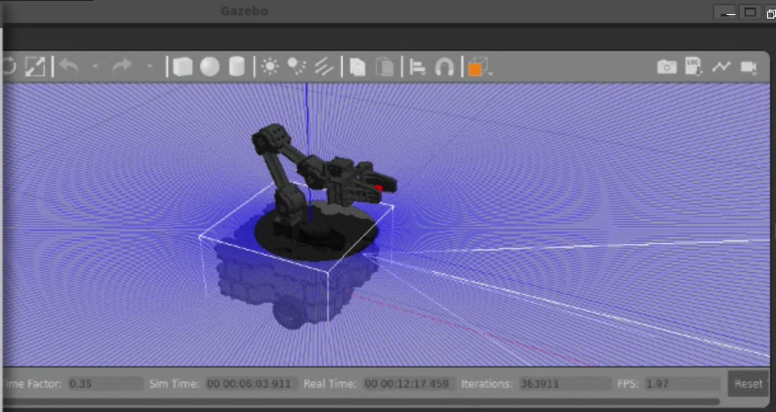
Simulation in ROS
ROS: firmware/software libraries
Rviz: 3D visualization tool for trajectory control
Gazebo: simulation environment and world editor
Notes:
Simulation in ROS and Gazebo - Ellie
Screenshot of simulation and controls
Explain how the controls will affect the simulation

Slide 13
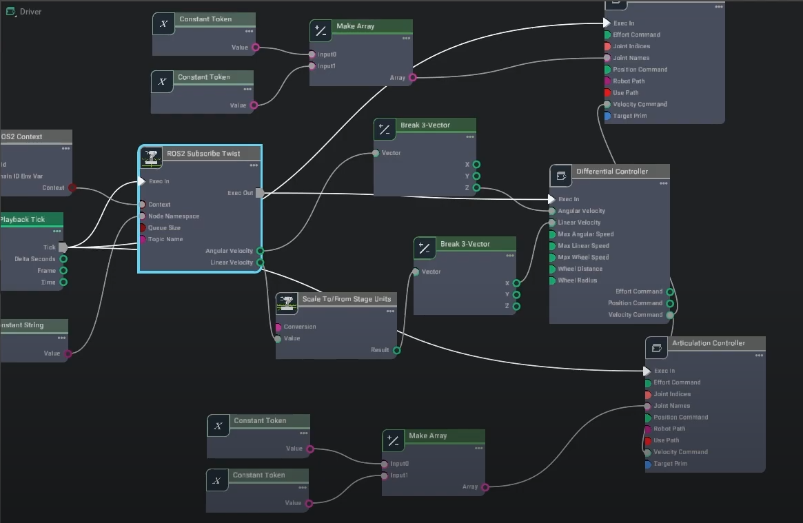
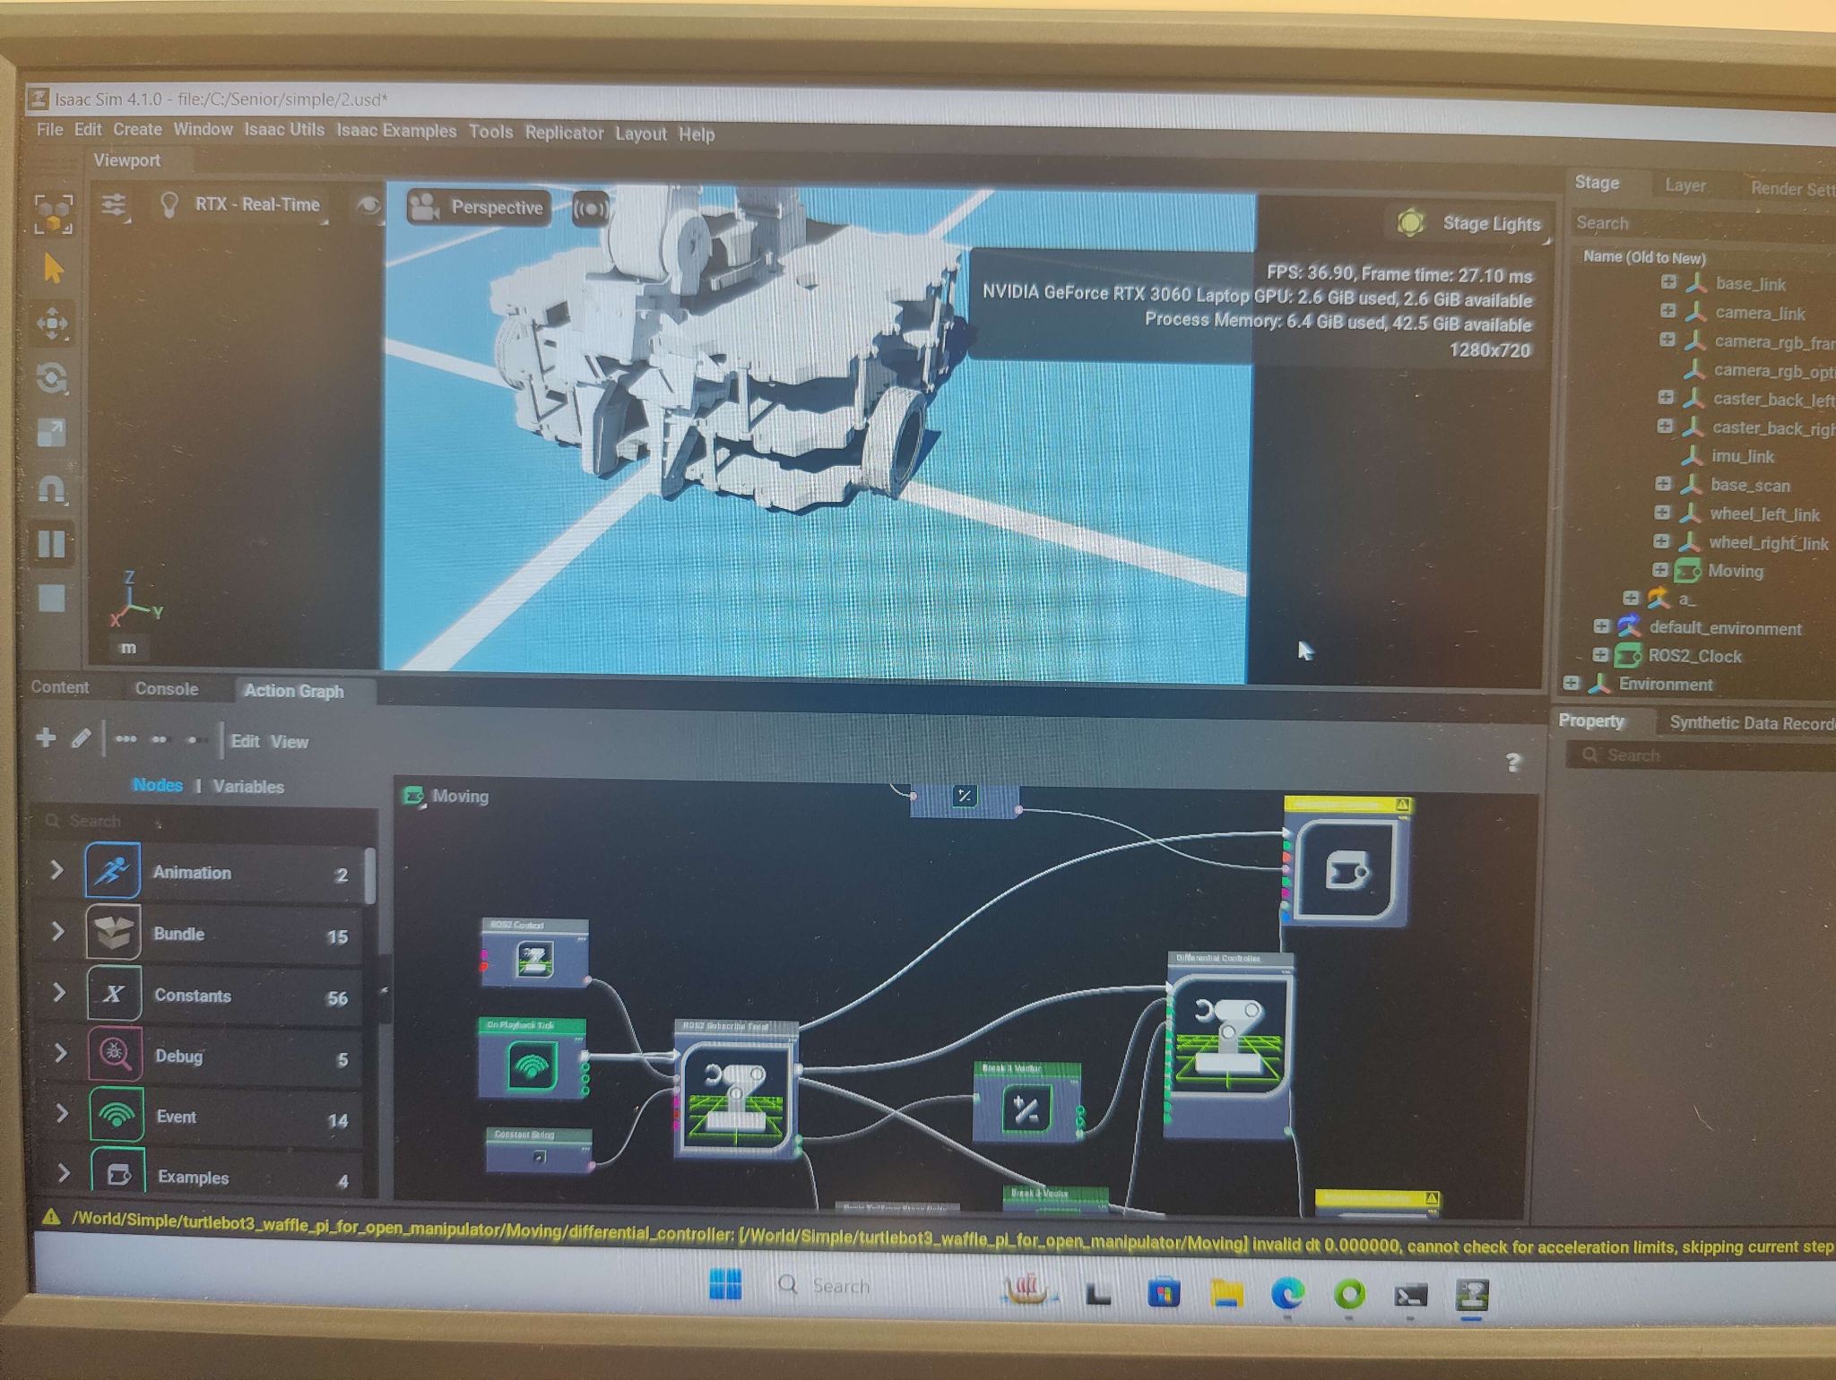
Simulation in Isaac
NVIDIA Isaac: utilizes CLI interface and action graph
Notes:
Isaac simulation - Zhiwen Zheng
Screenshot of simulation and controls
Explain how the controls will affect the simulation

Slide 14
Hardware Application and Future Goals
Hardware Shipment
Model Improvement
Future
Goals
We are currently waiting on the hardware to be delivered to the school.
We are actively enhancing the model in simulation while we wait for physical resources to become available
Upon hardware delivery:
Upload the models to the physical system
Test in a lab environment
Modify the models as needed
Notes:
Hardware shipment & model improvement - Zhiwen
Future goals - Ellie

Slide 15
Thank you
Any questions?
We submitted our powerpoint slides prior to this presentation

